Slide 1
COLLEGE SEMINAR | CLOUD COMPUTING
OpenStack
Architecture & Operations
Part 2: Conceptual Architecture · Service Dependencies · Modes of Operations
Continuing from: Overview & 9 Core Components

Slide 2
Conceptual Architecture of OpenStack
An expanded view of the OpenStack platform that shows the relationships among its different services and between the services and Virtual Machines (VMs). It's also called the 'magnified architecture' of OpenStack.
Service Relationships
Modular by Design
Shows how each component depends on and communicates with others
Services can be turned ON or OFF based on the VM required
Single Ecosystem
Built on Dependencies
All services co-exist and collaborate to produce a VM
Each service has hard dependencies and optional dependencies
API Communication
Unified Platform
Services interact via REST APIs and privileged admin commands
All components work together to deliver cloud services to users

Slide 3
Three Cross-Cutting Services
Horizon · Keystone · Ceilometer — shown at the top of the OpenStack platform
HORIZON
KEYSTONE
CEILOMETER
Dashboard
Identity Service
Telemetry
▸ Provides web-based UI for users & admins
▸ Central authentication for all services
▸ Monitors the entire OpenStack cloud
▸ Allows interaction with all OpenStack services
▸ Maps users to accessible OpenStack services
▸ Handles billing & usage reporting
▸ Single pane of glass for the cloud platform
▸ Manages tokens, roles & service catalog
▸ Enables scalability benchmarking
▸ Admin can manage projects, users & quotas
▸ Every service depends on Keystone
▸ Provides all telemetry data for the platform

Slide 4
Core Platform Services
Inside the OpenStack platform — each service has a distinct responsibility
Nova
Compute Engine
Glance
Image Service
Main computing engine of OpenStack. Provisions and manages Virtual Machines using disk images. Depends on Keystone, Horizon, and Glance. Optional: Cinder, Neutron.
Registers Hadoop images, provides image services to OpenStack, and allows retrieval and storage of disk images. Stores images in Swift.
Swift
Object Storage
Cinder
Block Storage
Responsible for reading service and storing data in the form of objects and files. All OpenStack components store data here, including job binaries.
Offers permanent block storage (volumes) to VMs. Also stores backup volumes in Swift. Essential for persistent data requirements.

Slide 5
Networking, Orchestration & More
Supporting services that extend OpenStack's capabilities
Neutron
Network Service
Heat
Orchestration
Enables network connectivity for VMs. Facilitates PXE Network for Ironic which fetches images via Glance. Depends on Keystone and Nova.
Infrastructure orchestration component.Automatically Manages resource requirements of cloud applications. Orchestrates clusters and coordinates all infrastructure needs.
Trove
Database Service
Sahara
Data Processing
Stores backup databases in Swift. Boots database instances via Nova. Provides database-as-a-service capabilities for cloud users.
Offers a simple means of providing a data processing framework to cloud users. Simplifies big data workloads on OpenStack.

Slide 6
Service Dependencies
Table 4.14 — Each service's hard requirements and optional dependencies
Service | Dependent On | Optional
Nova (Compute) | Keystone, Horizon, Glance | Cinder, Neutron
Swift (Object Storage) | Keystone | —
Cinder (Block Storage) | Keystone | —
Glance (Image Service) | Swift, Keystone, Horizon | —
Neutron (Network) | Keystone, Nova | —
Keystone (Identity) | — | —
Horizon (Dashboard) | Keystone | —

Slide 7
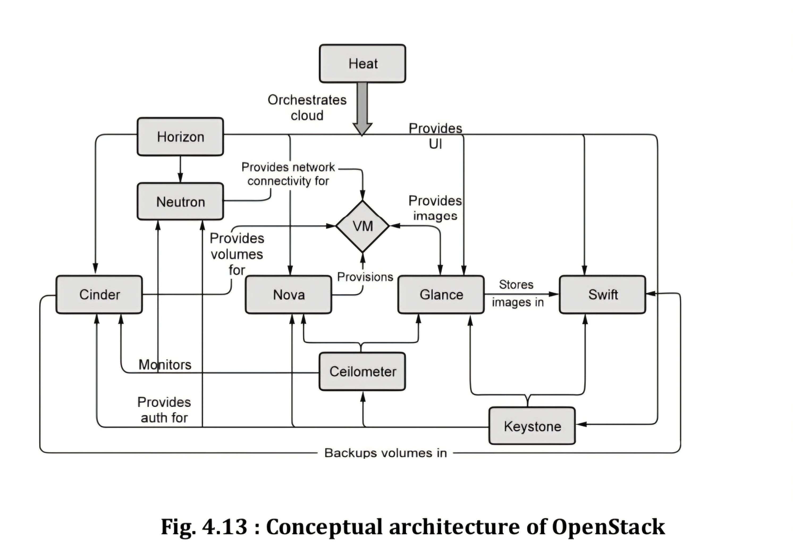

Slide 8
Modes of Operation
OpenStack operates in two primary network modes
SINGLE HOST
MULTI HOST
● Network services based on a central server
● Each compute node has a copy of the network
● Floating IPs hosted on the cloud controller
● Nodes act as individual Internet gateways
● Security groups managed on cloud controller
● Floating IPs hosted on each compute node
● Simple to set up and manage
● Security groups on each compute node
● All network traffic flows through ONE node
● Requires unique public IP per compute node

Slide 9
Single Host vs Multi Host — Comparison
Feature | Single Host | Multi Host
Network Location | Central server | Each compute node
Floating IPs | Cloud controller | Individual compute nodes
Security Groups | Cloud controller | Individual compute nodes
Fault Tolerance | Low — single point of failure | High — distributed across nodes
Public IP Needed | Only for cloud controller | One per compute node
Setup Complexity | Simple | More complex
Failure Impact | Entire system fails if controller fails | Only affected node goes down

